Slide 1
Academic Affair Committee Ethiopian Student Association, IITR Advisor Selection-PHD/M.Tech
July 2023

Slide 2
Faculty Profile Assessment
STUDENT should assess faculty profile from the portal of IITR before Advisor selection and in-person discussion.
Advisor will determine all study time
Its recommended that Ethiopian to advise senior student from their department before going to the department for advisor selection
A faculty with abroad and international student advising
Experience is preferable.

Slide 3
Faculty Profile Assessment
Process of Faculty Profile assessment
Assess
Senior Student Experience
Your department
Academic committee/ other Ethiopia student
Online Faculty profile abroad
Abroad Experience
International Student Advising

Slide 4
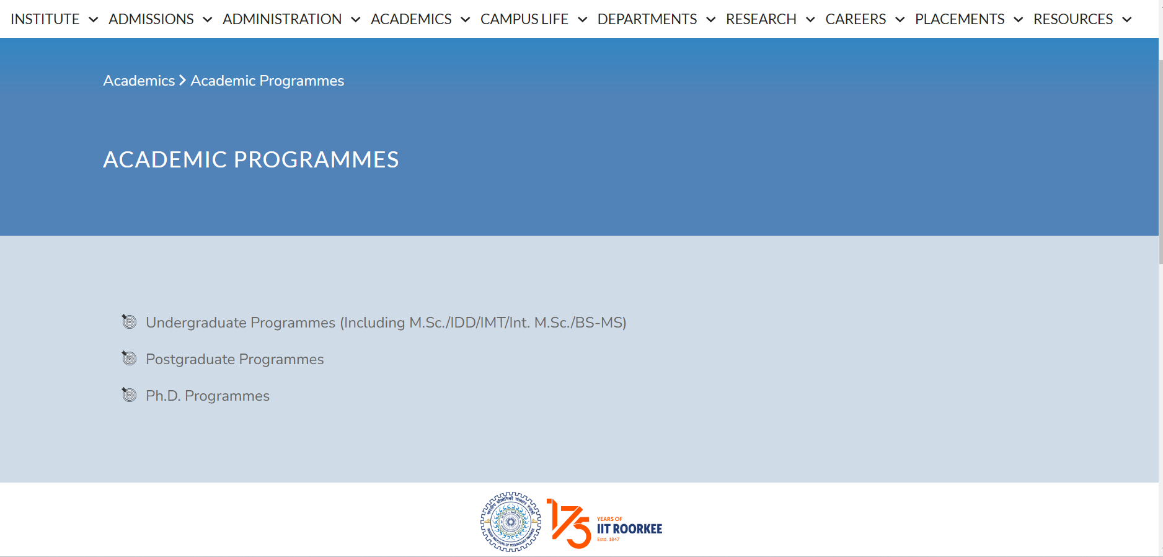
Faculty Profile Assessment
Faculty Profile assessment link
https://iitr.ac.in/Academics/Academic%20Programmes.html

Slide 5
Thanks…

